Slide 1
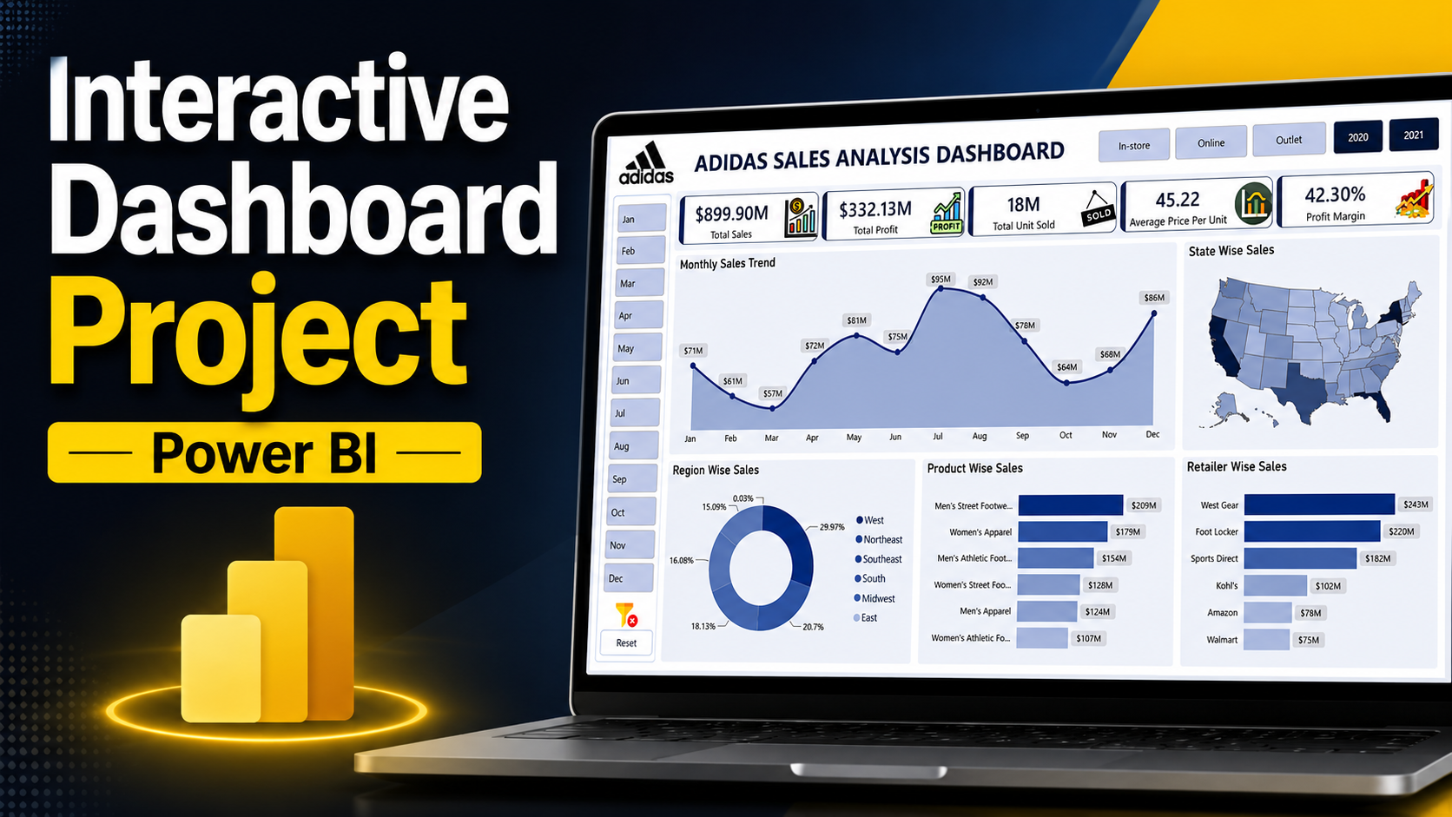

Slide 2
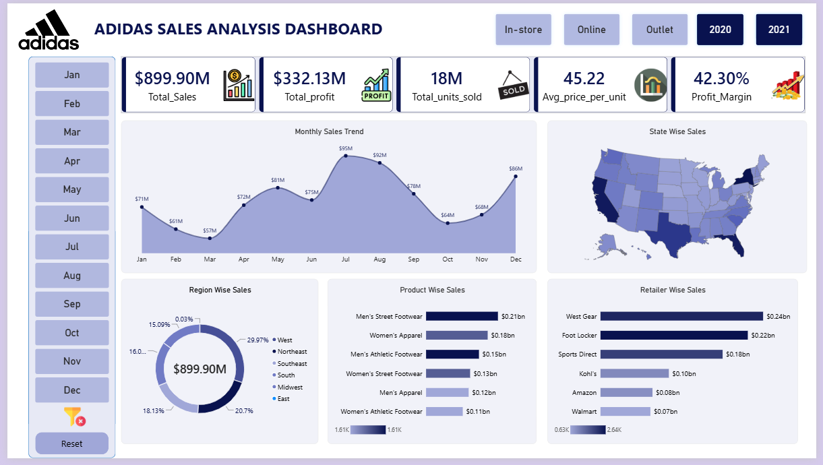

Slide 3
Business Requirements
The business requires an interactive dashboard that enables stakeholders to:
Monitor overall sales, profit, units sold, average selling price, and profit margin.
Analyse monthly sales trends to identify seasonal patterns.
Compare sales performance across regions and states.
Evaluate the contribution of different retailers and product categories.
Enable users to filter data by Region and Invoice Date.
Identify top-performing products and retailers to support strategic planning.

Slide 4
Key Performance Indicators (KPIs)
The dashboard should provide the following KPIs:
Total Sales – Overall revenue generated.
Total Profit – Total profit earned from sales.
Total Units Sold – Number of units sold.
Average Price per Unit – Average selling price of products.
Average Profit Margin (%) – Percentage profit earned on sales.
These KPIs provide a quick overview of the company's overall business performance.

Slide 5
Dashboard Visualization Requirements
The dashboard should include the following visualizations:
Monthly Sales Trend – Analyze sales performance across different months.
Sales by State – Visualize geographical sales distribution.
Sales by Region – Compare revenue contribution across regions.
Sales by Product – Identify best-selling product categories.
Sales by Retailer – Compare retailer performance based on total sales.
Sales Method Slicer – Filter the report by sales method.
Date Slicer – Filter the report by Month and Year.
These visualizations help stakeholders understand sales trends, regional performance, customer channels, and product demand, enabling informed business decisions.

